Slide 1



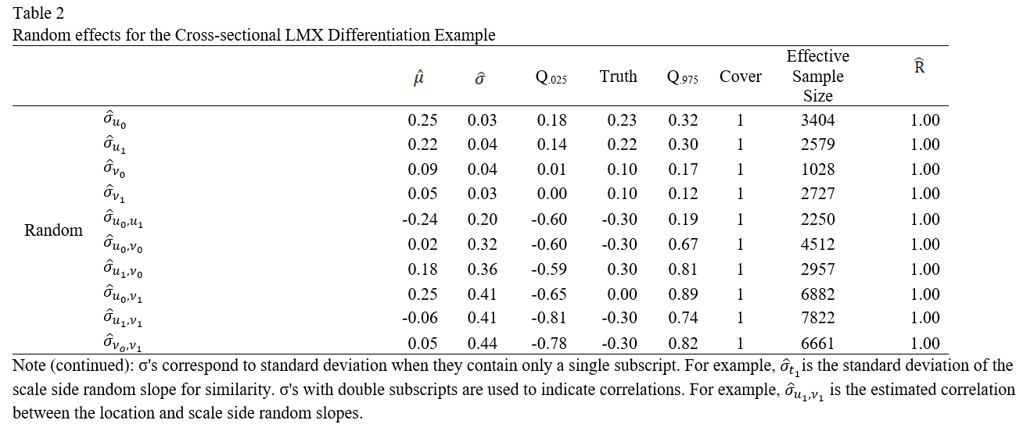
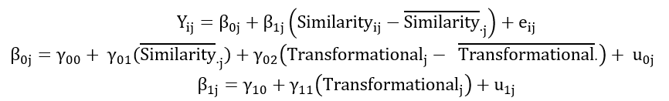





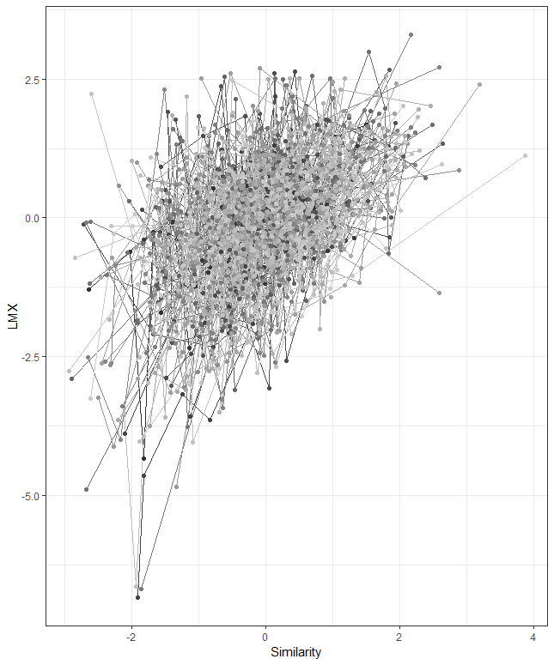
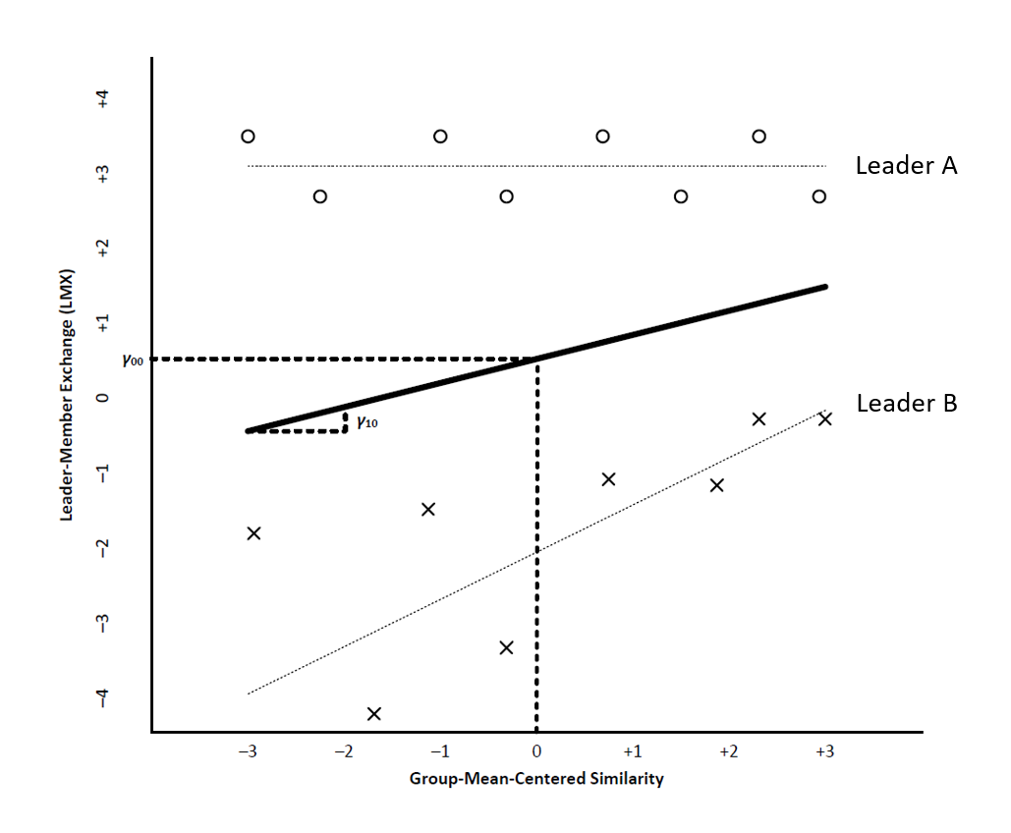
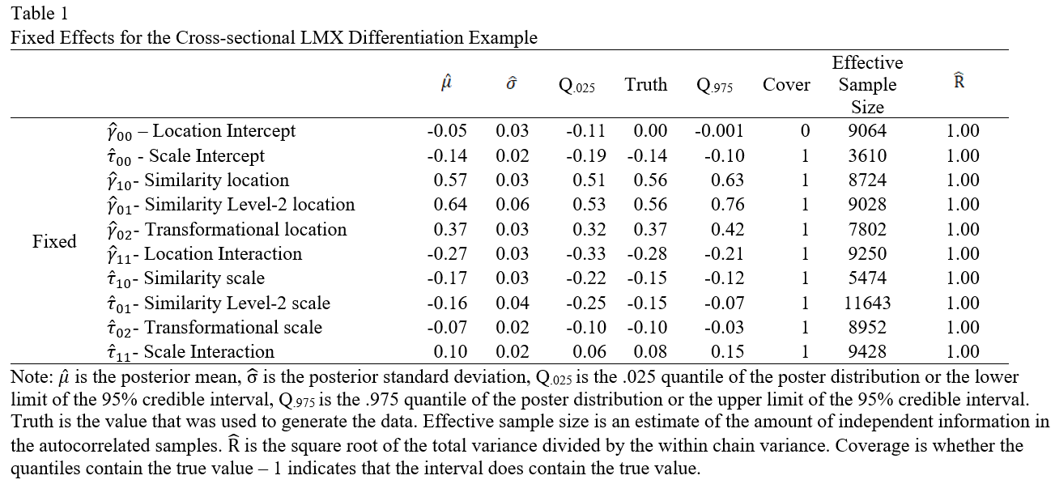

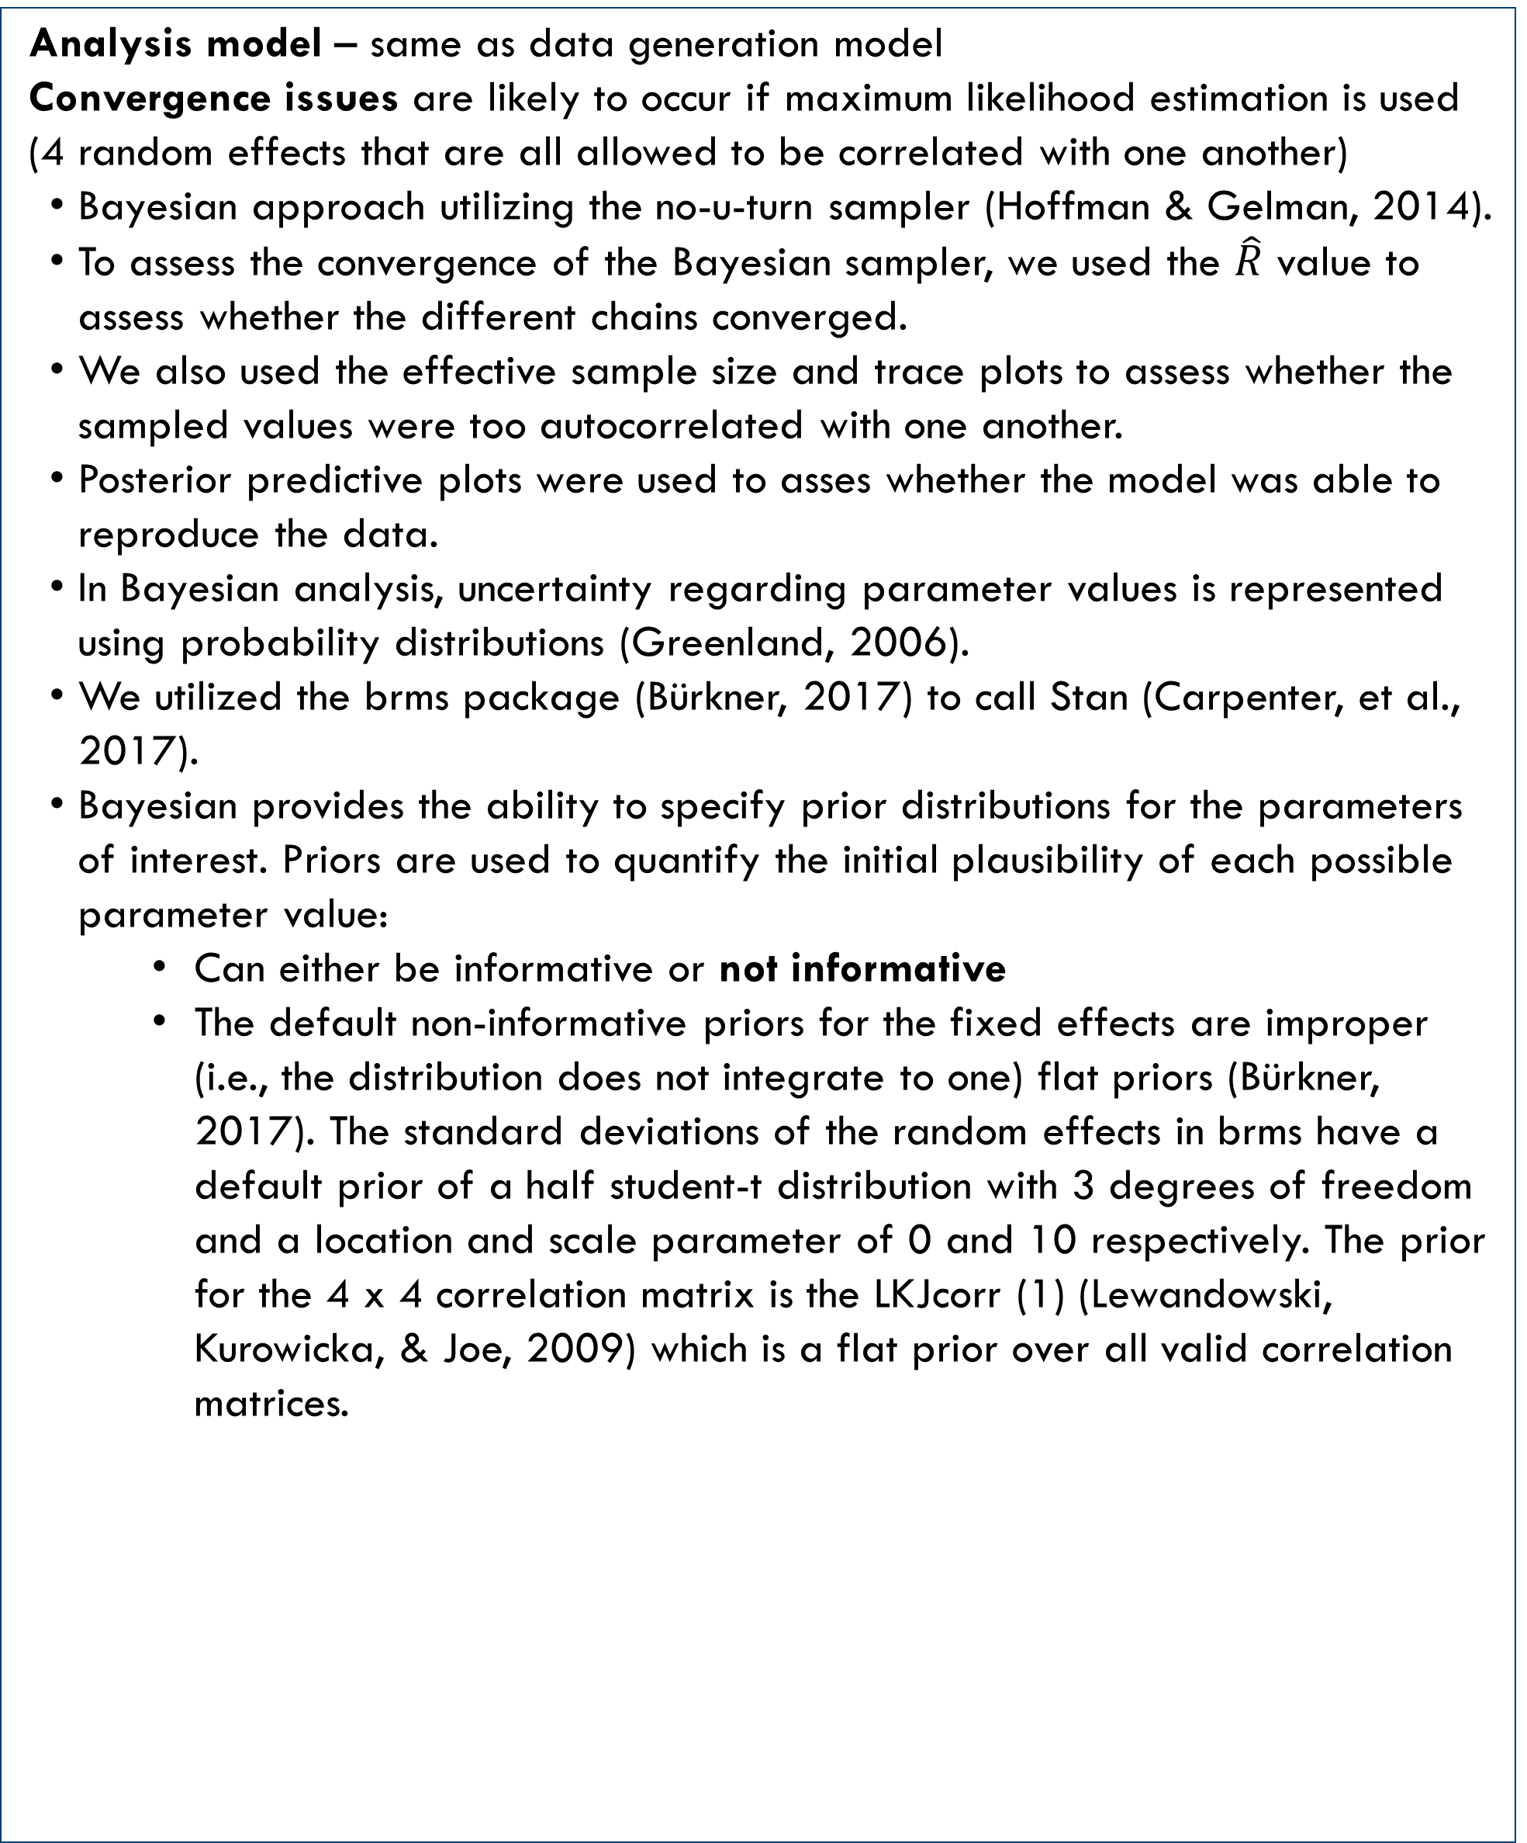

Houston F. Lester¹, Kristin L. Cullen-Lester², & Ryan W. Walters³
¹Center for Innovations in Quality Effectiveness and Safety, Michael E. DeBakey VA Medical Center, ² University of Houston, C. T. Bauer College of Business,
³ Creighton University School of Medicine
From Nuisance to Novel Research Questions: Using Multilevel Models to Predict Heterogeneity of Variance
Background
Method
Method cont.
Results cont.
Organizational researchers commonly examine the level (mean) of a construct as both a predictor and an outcome of substantive interest, whereas the variability of a construct tends to be examined for instrumental purposes.
For example, calculating agreement among members of a group to justify the aggregation of a level-one variable.
However, theoretically meaningful interpretations of variability exist in many areas of organizational research (e.g., personality consistency; performance variability; LMX differentiation; pay dispersion)
Researchers typically aggregate (e.g., calculate a standard deviation) and use single level approaches to predict variability-based constructs.
Limitations of this approach:
Inability to incorporate level one predictors.
Failure to account for the variability in the standard deviation estimates.
Researchers need different analytic tools, the mixed-effects location-scale (MELS; Hedeker, Mermelstein & Demirtas, 2008) model is one such tool.
Objectives:
To describe the mixed-effects location-scale model
To illustrate research questions this model allows researchers to address
We simulate a single, hypothetical example dataset that allows us to focus on the substantive considerations of this complex model as opposed to model selection.
Cross-sectional LMX differentiation example – illustrates how the MELS model can provide new insights into the nature of LMX differentiation.
Multiple subordinates report to (i.e., are nested within) the same supervisor
Predictors: leader’s ratings of perceived similarity (level-1) and the leader’s transformative leadership (level-2) as well as their interaction
Outcome: subordinates perceptions of LMX
Rationale for this example: Supervisors tend to develop different quality relationships with their subordinates resulting in a pattern of LMX that can be described by central tendency, variation, and relative position (Martin, et al., 2018). The MELS model allows researchers to predict all three of these properties in a single model, while appropriately considering model uncertainty and avoiding aggregation and its associated problems.
Analysis model – same as data generation model
Convergence issues are likely to occur if maximum likelihood estimation is used (4 random effects that are all allowed to be correlated with one another)
Bayesian approach utilizing the no-u-turn sampler (Hoffman & Gelman, 2014).
To assess the convergence of the Bayesian sampler, we used the $\hat{R}$ value to assess whether the different chains converged.
We also used the effective sample size and trace plots to assess whether the sampled values were too autocorrelated with one another.
Posterior predictive plots were used to asses whether the model was able to reproduce the data.
In Bayesian analysis, uncertainty regarding parameter values is represented using probability distributions (Greenland, 2006).
We utilized the brms package (Bürkner, 2017) to call Stan (Carpenter, et al., 2017).
Bayesian provides the ability to specify prior distributions for the parameters of interest. Priors are used to quantify the initial plausibility of each possible parameter value:
Can either be informative or not informative
The default non-informative priors for the fixed effects are improper (i.e., the distribution does not integrate to one) flat priors (Bürkner, 2017). The standard deviations of the random effects in brms have a default prior of a half student-t distribution with 3 degrees of freedom and a location and scale parameter of 0 and 10 respectively. The prior for the 4 x 4 correlation matrix is the LKJcorr (1) (Lewandowski, Kurowicka, & Joe, 2009) which is a flat prior over all valid correlation matrices.
The results revealed that the empirical and nominal coverage rates are equivalent to one another (i.e., the 95% credible intervals cover the data generating parameters for 19/20 data generating parameters).
The simple main effects of similarity on the location side of the model is estimated to be $\hat{γ}$₁₀ = .57, CI(.51, .63) indicating that subordinates with a leader who has an average amount of transformational leadership are predicted to have an .57 unit mean increase in LMX for each unit increase in similarity. This effect is dampened by the transformational leadership moderation effect, $\hat{γ}$₁₁ = .27, CI(-.33, -.21).
The $\hat{τ}10$ = -.17, CI(-.22, -.12) indicates that when transformational leadership is at its grand mean, the effect of a one unit increase in similarity is expected to decrease the log residual LMX standard deviation by .17. The cross-level interaction effect dampens the similarity effect by $\hat{τ}11$= .10, CI (.06, .15).
Mixed-effects location-scale Model
Data Generation
250 teams/groups with sizes ranging from 3 to 10 (M = 6.94, SD = 1.46)
Predictor variables were generated to be independent from one another. Values of the regression coefficients were chosen to reflect the correlation between LMX and transformation leadership and LMX and perceived similarity (r = .73 and .5, respectively Dulebohn et al., 2012). Correlations from the meta-analyses were converted to pseudo-R² values for each variance component (see Tables 1 and 2 for the exact values).
The direction of the relation between the predictors and LMX is built upon the following theoretical rationale
Perceived similarity is a predictor that has been found to be predictive of positive LMX relationships (Liden et al., 1993)
Moreover Hendersen et al. (2009) suggested that leaders high in transformational leadership may be less susceptible to similarity effects. From this we make the following hypotheses that are used to inform our data generating parameter values (see Tables 1 and 2)
Perceived similarity results in higher more consistent LMX, but those effects are ameliorated when a leader is high in transformational leadership
Transformational leadership is expected to result in high and consistent LMX when similarity is at its average levels (see Figures 1 and 2)
Discussion
Typical multilevel models assume homogeneity of variance both in terms of the residual and any additional variance partitioning.
MELS relaxes that assumption allowing researchers to predict heterogeneous variances using either categorical or continuous predictors.
MELS can be thought of as a joint multilevel model that performs a multilevel model for both the means (i.e., location as is commonly done) and the (residual) variances/standard deviation (i.e., the scale-side of the model).
The log of the standard deviation is used as the outcome to prevent negative predicted variances. The model presented below is parameterized using the standard deviation and is presented in matrix form to save space, but a notation similar to that presented in Raudenbush & Bryk (2002) can also be used (see Equations 2 and 3)
Location-side
Y_{i} is an n_{i} x 1 column vector of outcomes for individual or team i
X_{i} is an n_{i} x p matrix of p location-model fixed-effects (can be level-1 or level-2 predictors)
Z_{i} is an n_{i} x q matrix of q location-model level-1 predictors with location-model random effects
β is a p x 1 column vector of location-model fixed effects
b_{i} is a q x 1 column vector of q location-model random effects for individual/team i
e_{i} is an n_{i} x 1 column vector of residuals
Scale-side
W_{i} is an n_{i} x s matrix of s scale-model level-1 or level-2 predictors for the observations of individual/team i
A_{i} is an n_{i} x a matrix of a level-1 predictors that have scale-model random effects
Location and scale side random effects can be allowed to correlate with one another. Our implementation of the MELS model used Bayesian estimation with Stan (Carpenter et al., 2017).
Although still rare (relative to research predicting the mean of an outcome), interest in predicting variance-based constructs is increasing.
Constructs of interest span different disciplines, across micro, meso, and macro areas of research interest, and are used by researchers studying individuals, teams, business units, organizations and even industries.
Modeling of variability-based constructs has the potential to offer new and exciting insights for organizational researchers.
Researchers need to beyond commonly applied aggregation approaches that have several limitations that undermine the value of this research: (1) the inability to include level-one predictors and thus the inability to include random slopes and (2) disregarding the uncertainty in the variability of the variability estimate.
Use of the MELS model overcomes these limitations.
Results
Model diagnostics
Model convergence was not an issue ($\hat{R}$ < 1.05 for all parameter values, Asparouhov & Muthén, 2010).
The effective sample sizes greater than 1,000 (i.e., larger than 10% of the total, see Tables 1 and 2) indicate that excessive autocorrelation was not a problem. Trace plots (not presented due to space limitations) also reveal that autocorrelation was not a problem.
The posterior predictive plot (available upon request) reveals that the model is able to reproduce the data .
References
Asparouhov, T. & Muthén, B. (2010). Bayesian analysis using Mplus: Technical implementation. Technical Report. Version 3.
Bürkner, P.-C. (2017). Brms: An R package for Bayesian multilevel models using Stan. Journal of Statistical Software, 80. DOI: 10.18637/jss.v080.i01
Carpenter, B., Gelman, A., Hoffman, M. D., Lee, D., Goodrich, B., Betancourt, M., ... & Riddell, A. (2017). Stan: A probabilistic programming language. Journal of Statistical Software, 76. DOI: 10.18637/jss.v076.i01
Dulebohn, J. H., Bommer, W. H., Liden, R. C., Brouer, R. L., & Ferris, G. R. (2012). A meta-analysis of antecedents and consequences of leader-member exchange: Integrating the past with an eye toward the future. Journal of Management, 38, 1715-1759. DOI: 10.1177/0149206311415280
Greenland, S. G. (2006). Bayesian perspectives for epidemiological research: I. Foundations and basic methods. International Journal of Epidemiology, 35, 765-775. DOI: 10.1093/ije/dyi312
Hedeker D, Mermelstein RJ, Demirtas H. (2008). An application of a mixed-effects location scale model for analysis of ecological momentary assessment (EMA) data. Biometrics, 64, 627-634. DOI: 10.1111/j.1541-0420.2007.00924.x
Henderson, D. J., Liden, R. C., Glibkowski, B. C., & Chaudhry, A. (2009). LMX differentiation: A multilevel review and examination of its antecedents and outcomes. Leadership Quarterly, 20(4), 517–534. DOI: 10.1016/j.leaqua.2009.04.003
Hoffman, M. D., & Gelman, A. (2014). The No-U-turn sampler: adaptively setting path lengths in Hamiltonian Monte Carlo. Journal of Machine Learning Research, 15, 1593-1623.
Lewandowski, D., Kurowicka, D., & Joe, H. (2009). Generating random correlation matrices based on vines and extended onion method. Journal of Multivariate Analysis, 100, 1989-2001. DOI: 10.1016/j.jmva.2009.04.008
Liden, R.C., Wayne, S.J., & Stilwell, D. (1993). A longitudinal study on the early development of leader-member exchanges. Journal of Applied Psychology, 78, 662-674. DOI: 10.1037//0021-9010.78.4.662
Martin, R., Thomas, G., Legood, A., & Dello Russo, S. (2018). Leader–member exchange (LMX) differentiation and work outcomes: Conceptual clarification and critical review. Journal of Organizational Behavior, 39, 151–168. doi: 10.1002/job.2202
Raudenbush, S. W., & Bryk, A. S. (2002). Hierarchical linear models: Applications and data analysis methods (Vol. 1). Sage.
Figure 1. Spaghetti plot for the cross-sectional LMX differentiation example.
Figure 2. Two hypothetical leaders and their subordinates to illustrate the model’s implications.

